Slide 1

Free pizza & beer.... and other mistakes
Andy Mallon he/him
Slides

Slide 2

Andy Mallon
I sell furniture at the mall
Database Architect at Wayfair.com*
Working with SQL Server since the turn of the century
Background in Tech Support, Database Administration, and Database Architecture
Lazy
Impatient
* The views & opinions expressed in this presentation are mine alone and do not reflect the views of my employer.

Slide 3
About me
Unabashedly queer
I hate racism, homophobia, bigotry, and websites that require disabling my popup blocker to read the news
I love inclusive communities, helping others, dogs, and oxford commas

Slide 4
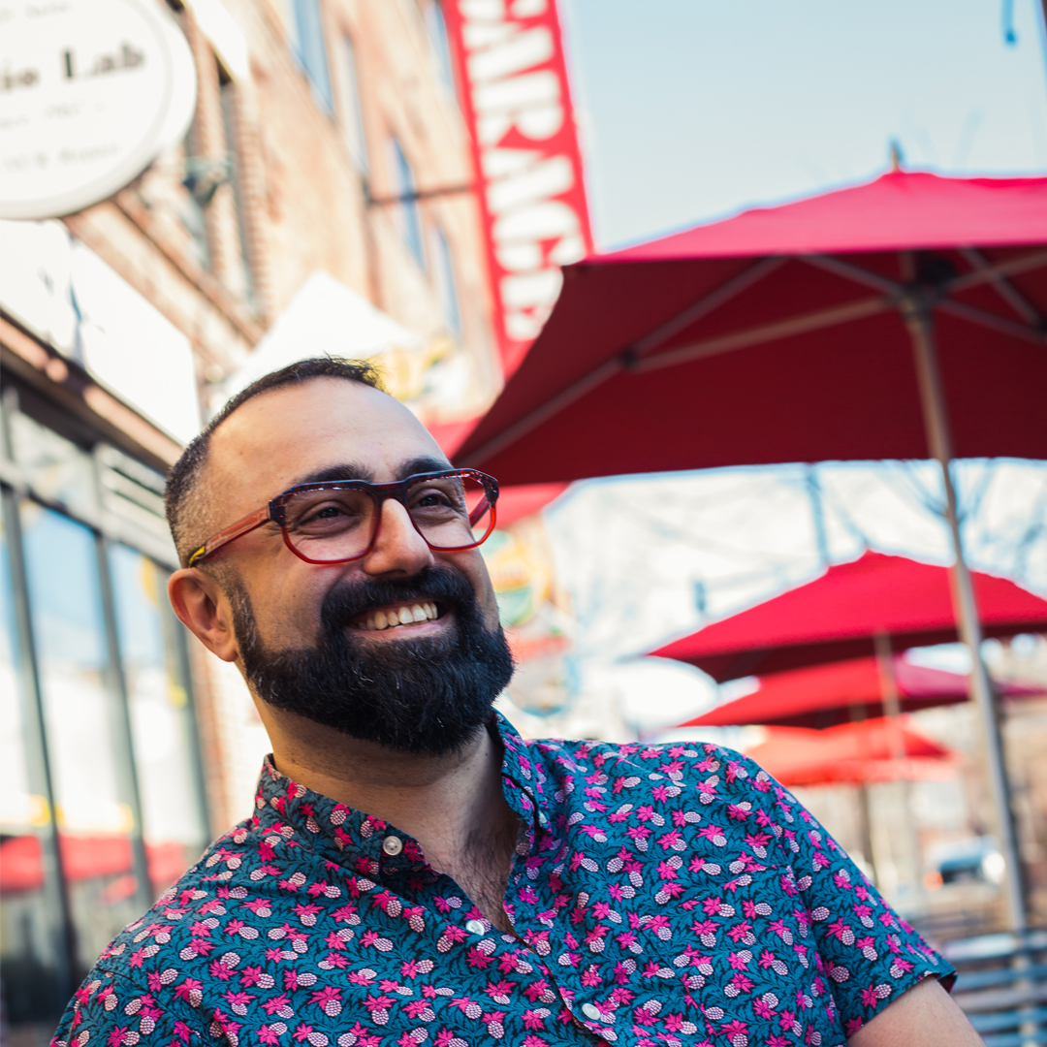
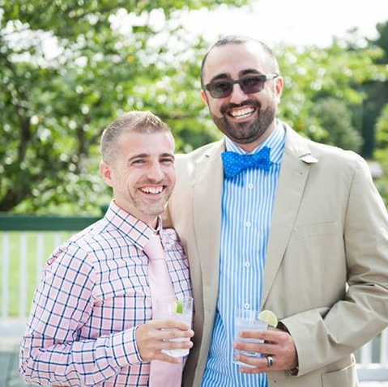
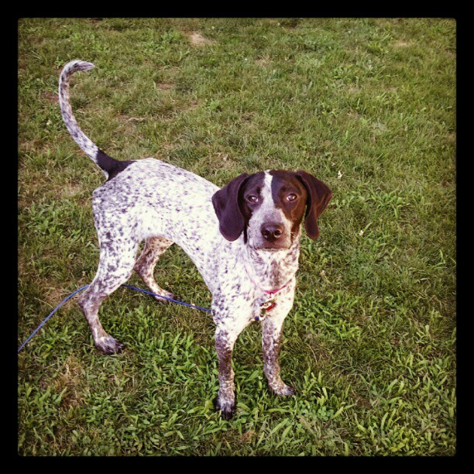
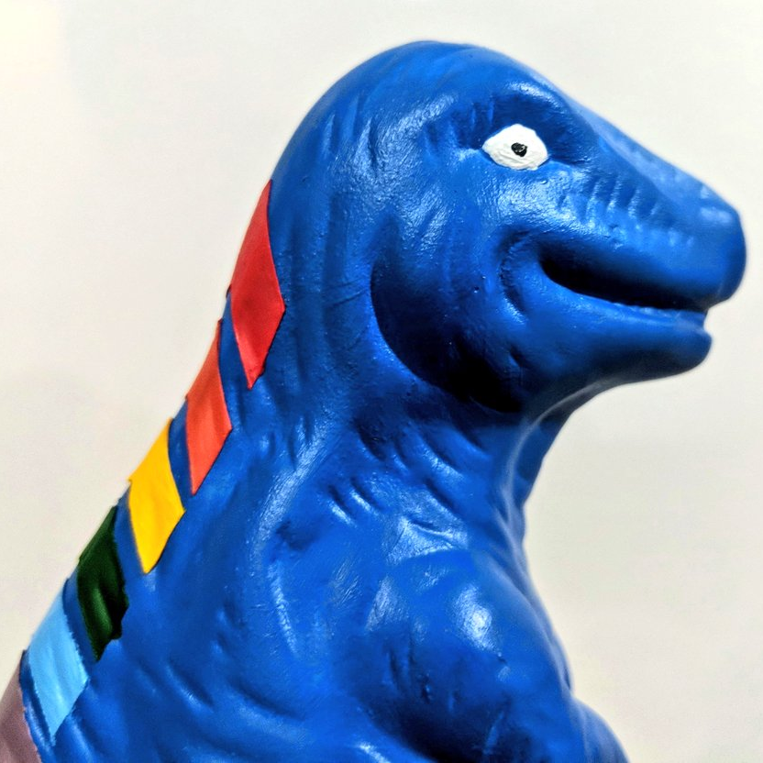
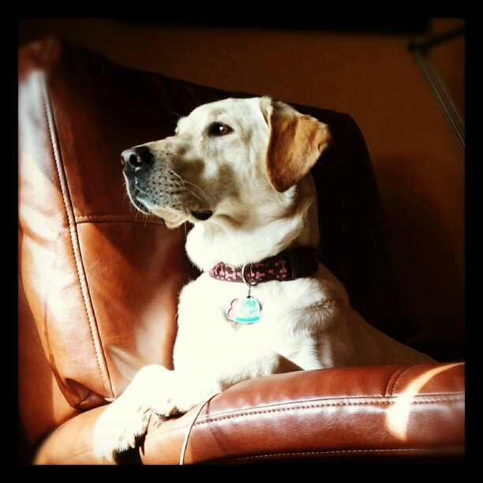

Notes:
Some of the things I love most in life– My husband, my pups, Queery the Diversity Dino.

Slide 5
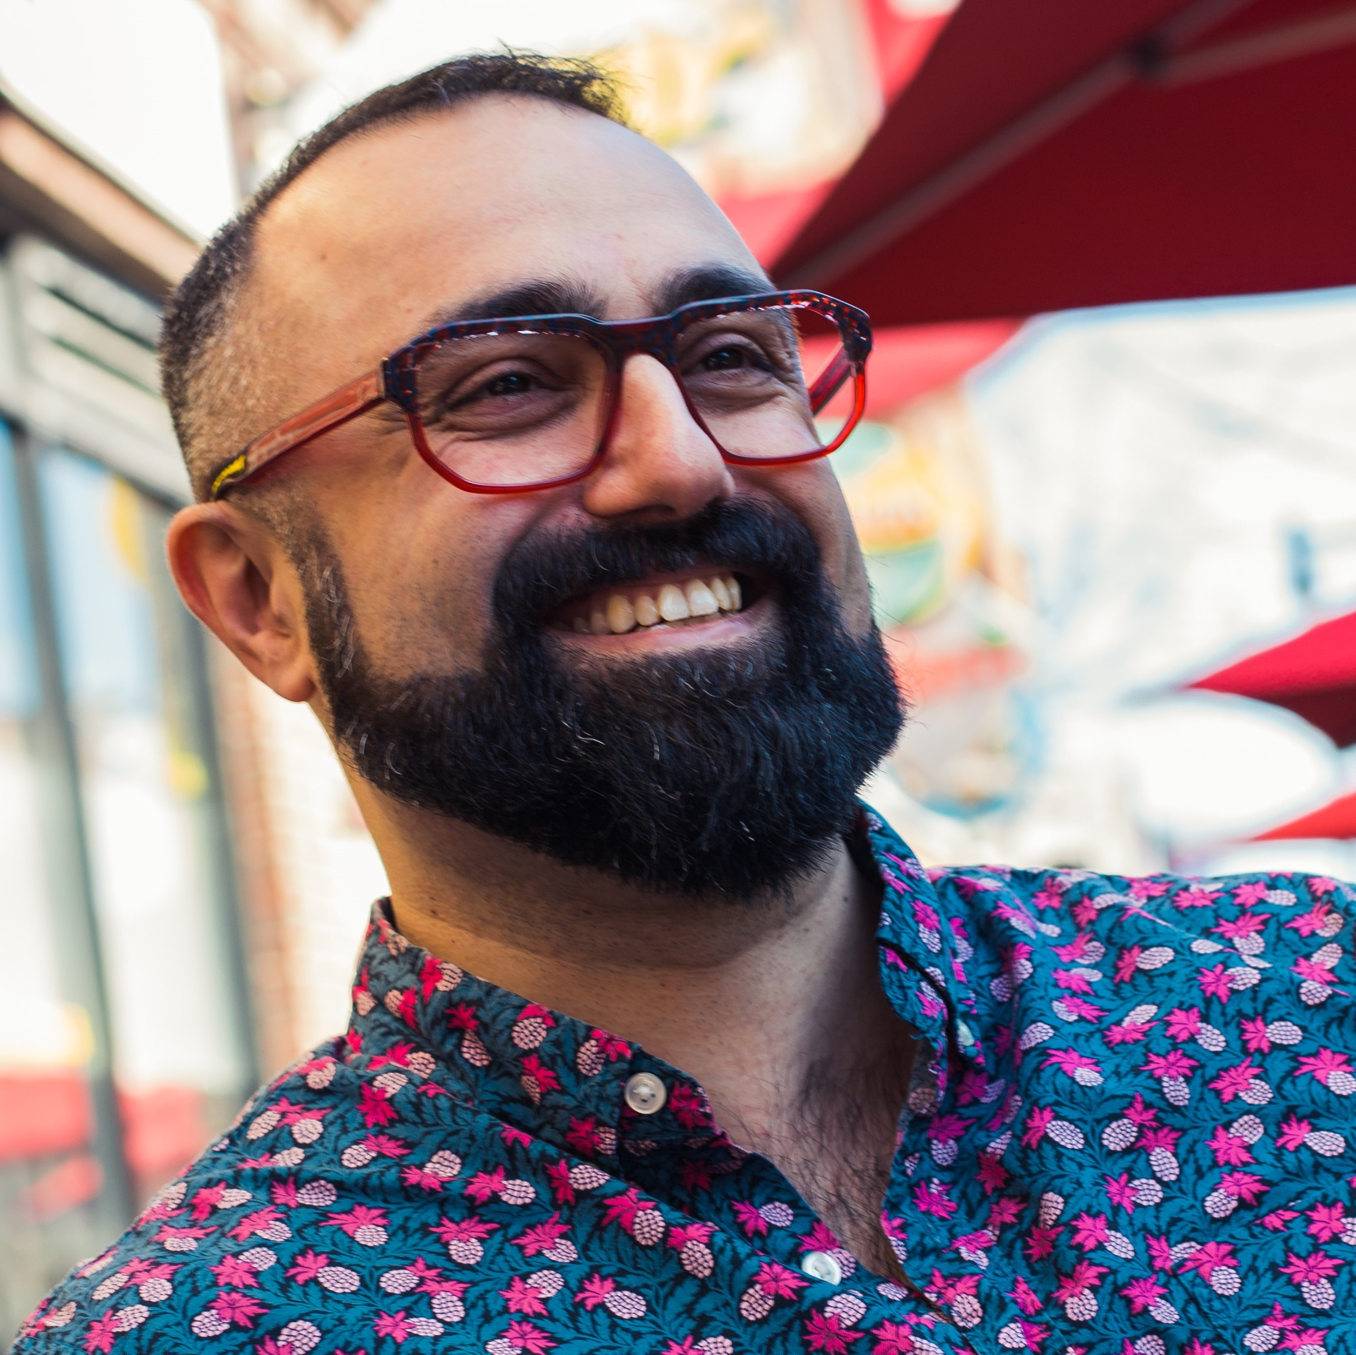


Contact Andy
Andy@AMtwo.co
@AMtwo
am2.co/shortcuts
andy@am2.co

Slide 6

Session Feedback
Tell me what you don’t like
Tell me what can be better
Tell me what you like

Slide 7


Yea…….You apparently didn’t put one of the new coversheets on your TPS reports.
I'm also gonna need you to go ahead and silence your phones and devices

Slide 8
Agenda
Learn some jargon
Diversity & inclusion are important
Starting at “diversity” is the wrong approach
Welcoming & Belonging
Equity & Inclusion
Tell some stories

Slide 9
Questions…
Ask questions as we go
<Mentimeter link / polls>

Slide 10
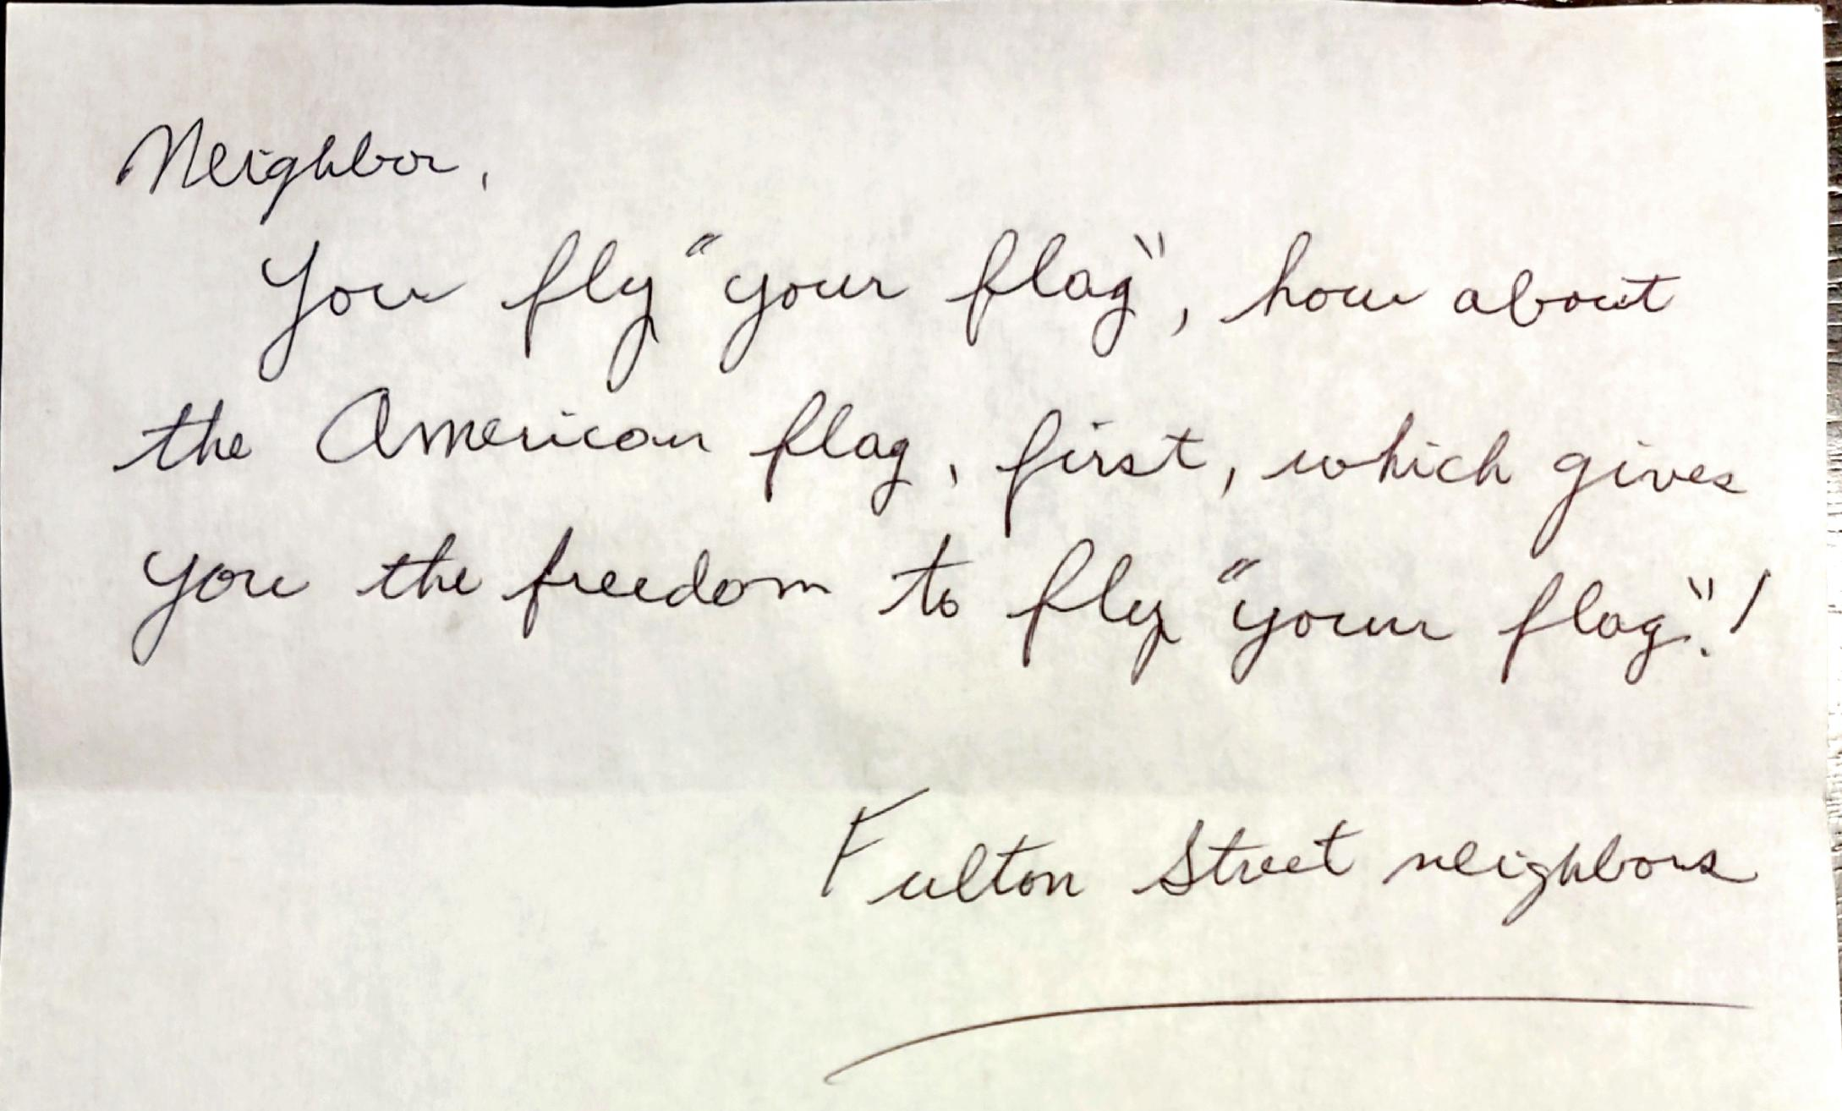
Let’s start with a story

Slide 11
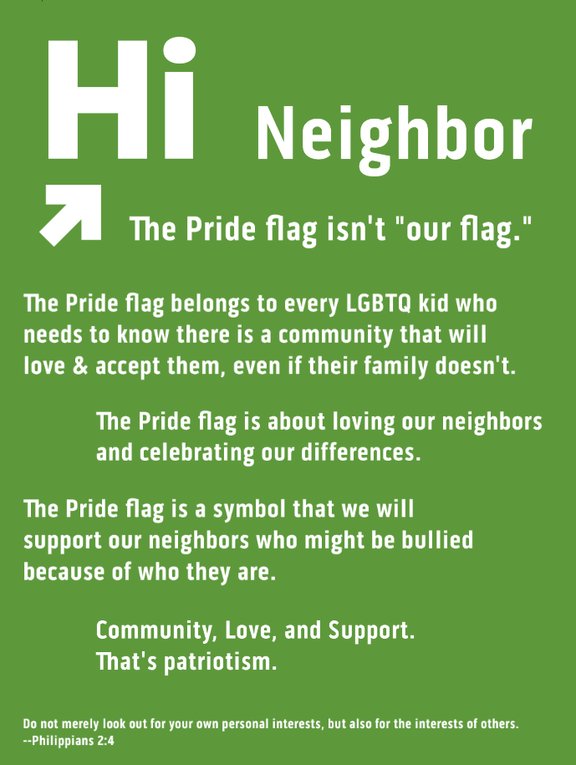
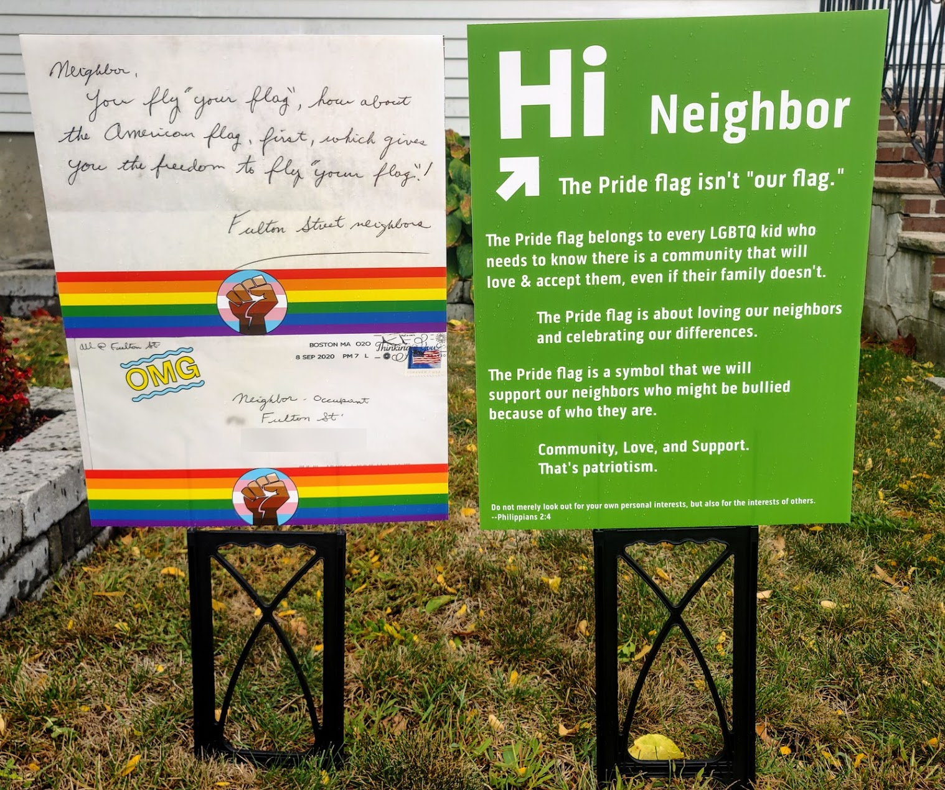
Hi Neighbor!

Slide 12
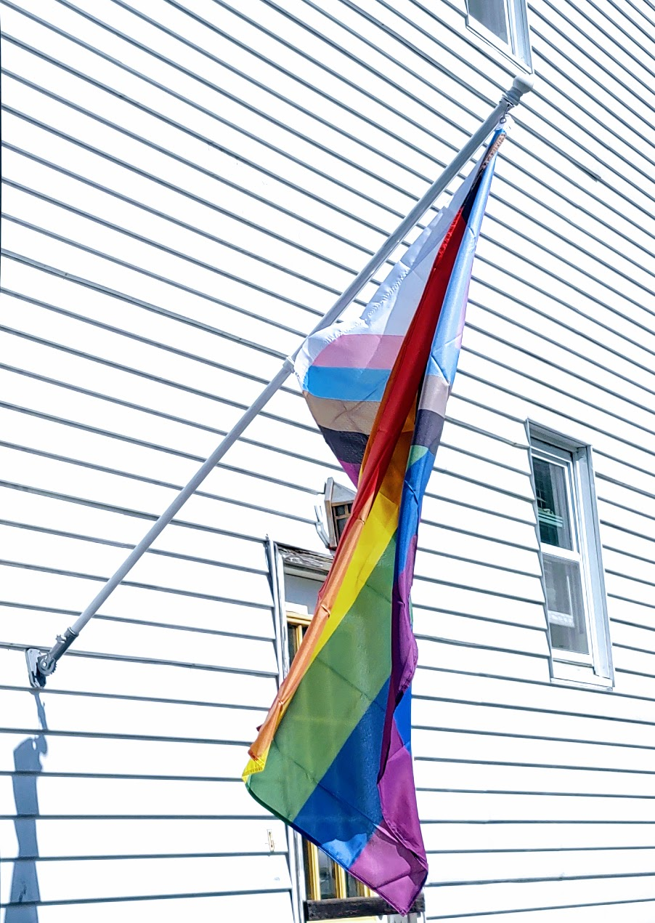
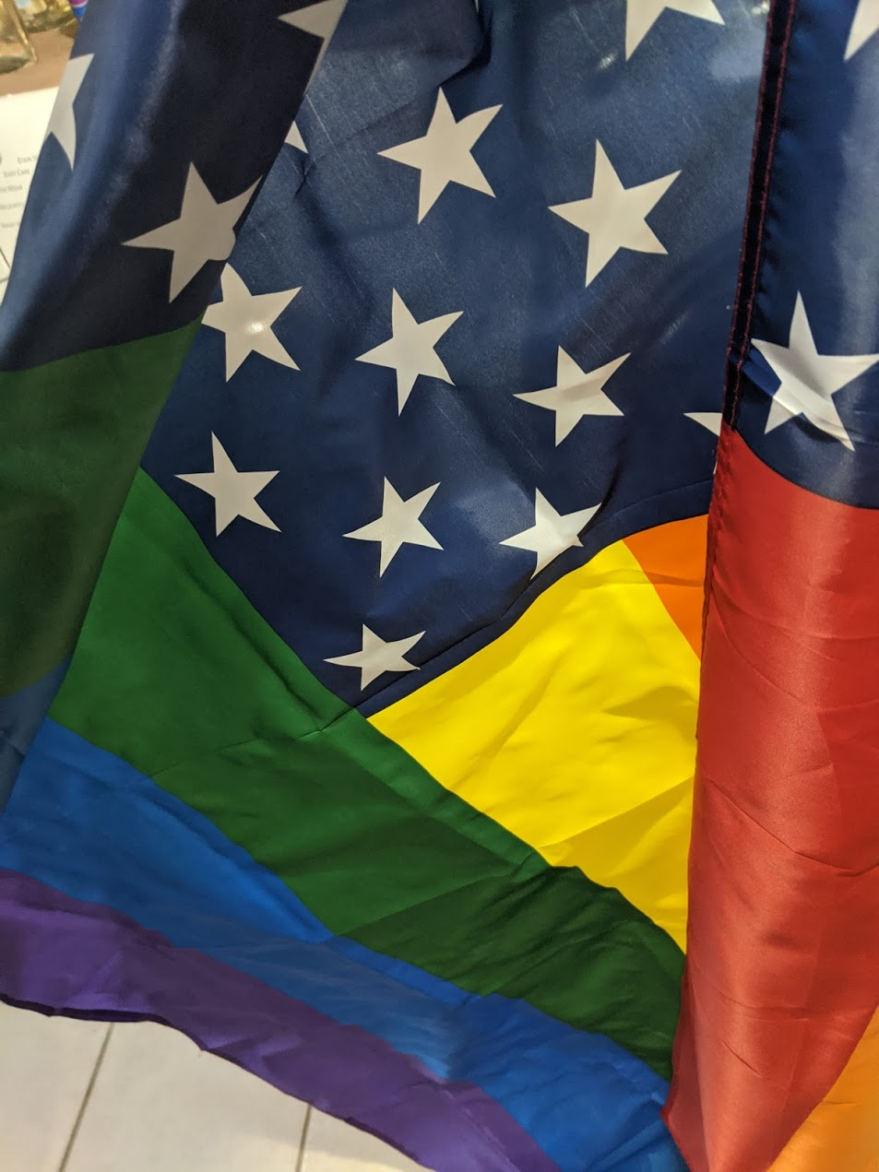

What is the Pride Flag?

Slide 13
Jargon
Diversity
Equity
Inclusion
Intersectionality
Belonging

Slide 14
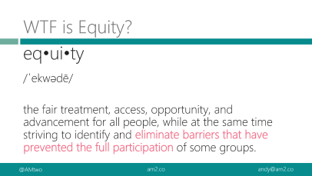
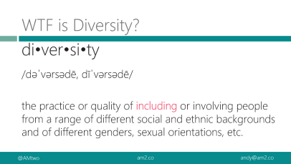
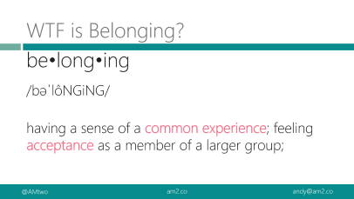
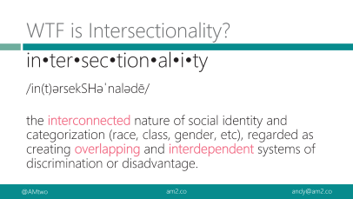
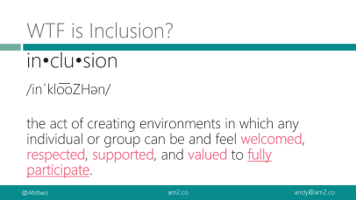
Definitions are boring
we are not going to read definitions today
Download the slides if you prefer a formal vocabulary lesson

Slide 15
WTF is Diversity?
di•ver•si•ty
/dəˈvərsədē, dīˈvərsədē/
the practice or quality of including or involving people from a range of different social and ethnic backgrounds and of different genders, sexual orientations, etc.

Slide 16
WTF is Equity?
eq•ui•ty
/ˈekwədē/
the fair treatment, access, opportunity, and advancement for all people, while at the same time striving to identify and eliminate barriers that have prevented the full participation of some groups.
Notes:
Improving equity involves increasing justice and fairness within the procedures and processes of institutions or systems, as well as in their distribution of resources.

Slide 17
WTF is Inclusion?
in•clu•sion
/inˈklo͞oZHən/
the act of creating environments in which any individual or group can be and feel welcomed, respected, supported, and valued to fully participate.
Notes:
An inclusive and welcoming climate embraces differences and offers respect in words and actions for all people.
Diverse environments that are not inclusive aren’t helpful---it’s just a gathering of “tokens”

Slide 18
WTF is Intersectionality?
in•ter•sec•tion•al•i•ty
/in(t)ərsekSHəˈnalədē/
the interconnected nature of social identity and categorization (race, class, gender, etc), regarded as creating overlapping and interdependent systems of discrimination or disadvantage.
Notes:
Intersectionality takes into account people’s overlapping identities and experiences in order to understand the complexity of prejudices they face.

Slide 19
WTF is Belonging?
be•long•ing
/bəˈlôNGiNG/
having a sense of a common experience; feeling acceptance as a member of a larger group;
Notes:
A sense of belonging is something we all feel & know, but it’s hard to define A sense of belonging to a greater community improves your motivation, health, and happiness. When you see your connection to others, you know that all people struggle and have difficult times. You are not alone. There is comfort in that knowledge.

Slide 20
Definitions are boring
Diversity is having a seat at the table, inclusion is having a voice, and belonging is having that voice be heard.
~ Liz Fosslien and Mollie West Duffy (lizandmollie.com)

Slide 21
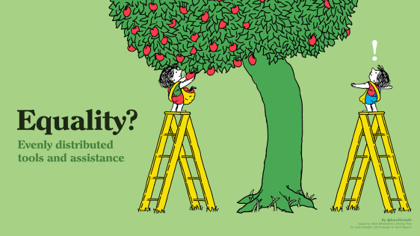
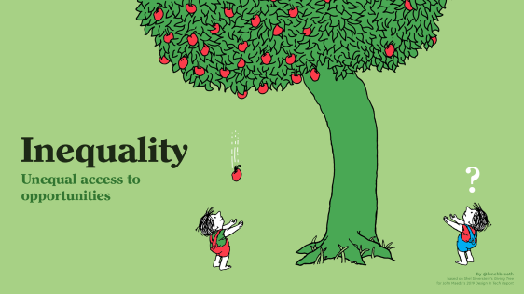
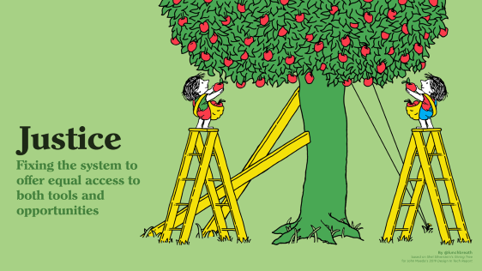
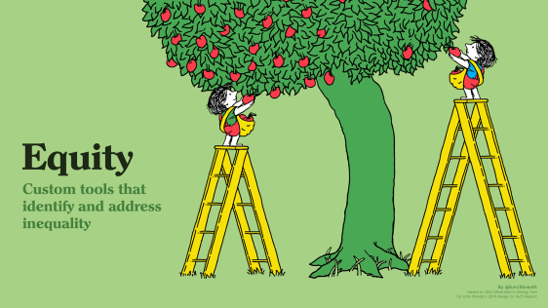

Slide 22

Notes:
1/ Inequality means being born on the wrong side of the tree versus the better side.

Slide 23
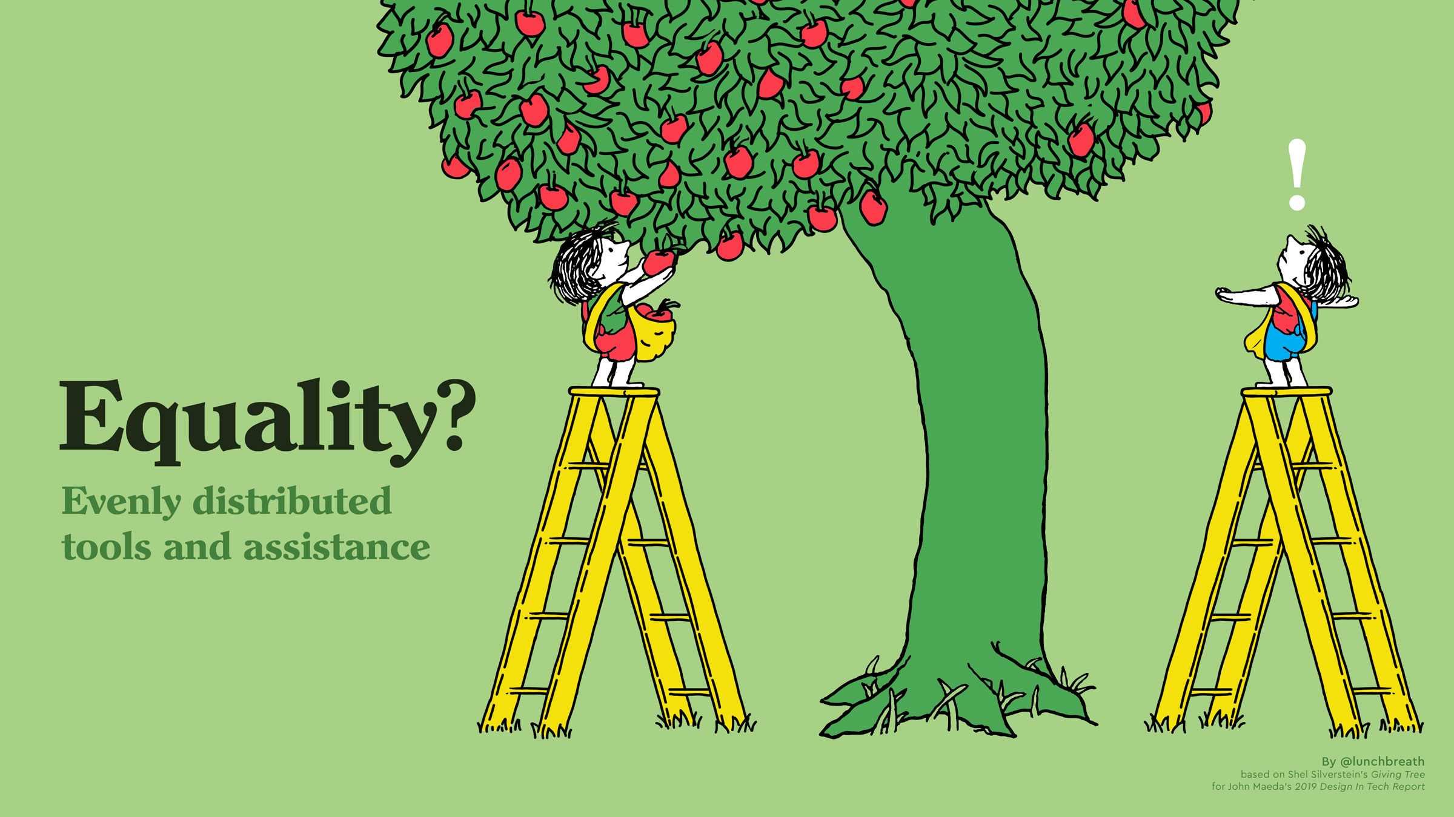
Notes:
2/ Equality means trying to reconcile equity by giving an equal solution to both.

Slide 24

Notes:
3/ Equity means knowing that there’s a right-sized solution to each individual.

Slide 25

Notes:
4/ Justice means working to correct the system itself — e.g. tackling systemic racism.

Slide 26
Same-sex marriage
Nov 18, 2003: Goodridge v Dept of Public Health
May 17, 2004: 50th anniversary of Brown v Board of Education & first legal same-sex marriage

Slide 27
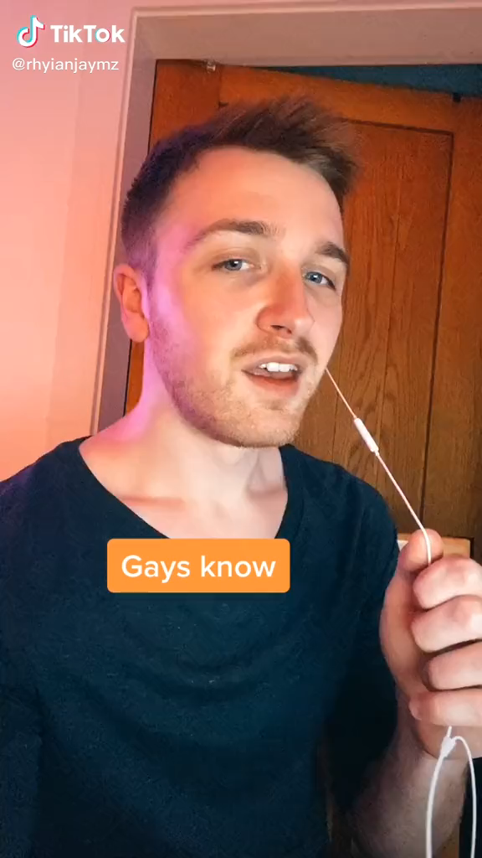
“To be gay is…
…to be recommended holiday destinations by friends and family which you can’t actually go on because being gay is illegal in that country, and if you went you’d probably get beaten, arrested, or something worse.”

Slide 29
Gatekeeping

Slide 30
GroupBy code of conduct

Slide 31
Segregating Diversity to a specific group
Inclusion has to run through the whole org

Slide 32
I f*cked up framework

Slide 33
As a manager
People don’t know your intent unless you tell them
You can do racist things, even if YOU aren’t racist
Don’t get defensive
Ex) Someone says you are racist
Ask why they think that. What actions made them decide that was your motivation
Find common ground
Clarify intent, fix actions next time, etc

Slide 34
Socially acceptable racism changes with time.
“We’ve always done it that way” isn’t an excuse for racism.

Slide 35
Good faith vs bad faith arguments

Slide 36
Belonging brainstorm
Some seek belonging through excluding others. That reflects the idea that there must be those who don't belong in order for there to be those who do.

Slide 37
More reading
Beyond the DE&I Acronym: What are Diversity, Equity, and Inclusion?
What is intersectionality, and what does it have to do with me?

